Slide 1
CO 3 -COMMUNICATION INTERFACES AND PROTOCOLS
Interfacing Buses
Serial Interfaces
RS232/UART
UART Programming
RS422/RS485
I2C Interface
SPI Interface
I2C/SPI Programming
USB

Slide 2
Introduction
Most of the embedded systems have to interface with the external world.
This requirement may be to transmit the data to a PC or workstation or to interact with another system for sharing the data.
To meet this requirement , the embedded system need to be provided with communication interfaces.

Slide 3
Need for Communication Interfaces
Send data to a host or PC
Communicate with another embedded system to transmit or receive data.
A number of embedded systems need to be networked to share data.
An embedded system need to be connected to the Internet so that anyone can access the embedded system. Example : Real Time Weather Monitoring System.
Mobile devices such as cell phones and palmtops for data synchronization.

Slide 4
Communication Protocols
Definition:
Set of rules and message formats that govern data exchange between computer systems.
Main Functions:
Enable consistent message transmission and reception
Support error detection & correction
Handle signaling and authentication
Define syntax & semantics of communication
Bridge analog and digital communication

Slide 5
Role of Communication Protocols
Purpose:
Enable network devices to communicate by transmitting
Analog signals
Digital signals
Files and processed data
Applications:
Widely used in telecommunication systems
Essential in computer networks
Governed by rules for source-to-destination data transfer
Key Networking Protocols:
TCP (Transmission Control Protocol) – reliable, connection-oriented
UDP (User Datagram Protocol) – faster, connectionless

Slide 6
Types of Communication Protocols
There are two types of communication protocols which are classified below:
Inter System Protocol
Intra System Protocol

Slide 7
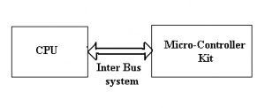
Inter System Protocol
The inter-system protocol - to communicate two different devices.
Like communication between computer to microcontroller kit.
The communication is done through an inter bus system.

Slide 8
The different categories of intersystem protocol mainly include the following.
UART Protocol
USART Protocol
USB Protocol

Slide 9
Types of Interfaces
1. Serial Communication
Sends data bit by bit (fewer pins, slower)
Examples: UART, I²C, SPI, CAN
2. Parallel Communication
Sends multiple bits at once (faster, more pins)
Example: Data bus in microprocessors

Slide 10
Common Interfaces
UART – Simple, point-to-point communication
I²C – Two-wire, multi-device, master-slave
SPI – Four-wire, high-speed, used for displays & memory
CAN – Reliable, used in automotive systems
USB – Standardized external device connection
Ethernet/Wireless (Wi-Fi, Bluetooth, ZigBee) – Networking & IoT

Slide 11
RS232
Standard developed by Electronic Industry Association (EIA).
Oldest and widely used communication interface.
PC will have 2 RS232 ports designated as COM1 and COM2.
Most of the microcontrollers have on chip serial interface.
RS232 is used to connect DTE (Data Terminal Equipment) to a Data Circuit Terminating Equipment (DCE).
DTE can be a PC, serial printer or a plotter.
DCE can be modem, mouse, digitizer or a scanner.

Slide 12
RS232
RS232 is a standard for serial communication i.e bits are transmitted serially.
Full Duplex Communication.

Slide 13
RS232 Communication Parameters
When two devices have to communicate through RS232, the sending device sends the data character by character.
The bits corresponding to the character are called data bits.
The bits are prefixed with a bit called start bit, suffixed with one or two bits called stop bits.
Mode of communication : Synchronous
Parity bit : error detection at the receiving end.

Slide 14
UART
Universal Asynchronous Receive Transmit (UART)
Processor process the data in parallel format , not in serial format.
To bridge the processor and the RS232 port, UART is used.
Converts the parallel data received from the processor into serial format.
Sends it to RS232 level shifter – takes the serial data and converts into parallel format.

Slide 15
UART stands for a universal asynchronous transmitter and receiver.
UART Protocols is a serial communication with two wired protocols.
The data cable signal lines are labeled as Rx and Tx.
Serial communication is commonly used for transmitting and receiving the signal.
It is transferred and receives the data serially bit by bit without class pulses.
The UART takes bytes of data and sends the individual bits in a sequential manner.

Slide 16
UART is a half-duplex protocol.
Half-duplex means transferring and receiving the data but not at the same time.
Most of the controllers have hardware UART on board.
It uses a single data line for transmitting and receiving the data.
It has one start bit, 8-bit data and a one-stop bit mean the 8-bit data transfer one’s signal is high to low.
Ex: Emails, SMS, Walkie-talkie.

Slide 17
USART
USART stands for a universal synchronous and asynchronous transmitter and receiver.
It is a serial communication of a two-wire protocol.
The data cable signal lines are labeled as Rx and TX.
This protocol is used to transmitting and receiving the data byte by byte along with the clock pulses.
It is a full-duplex protocol that means transmitting and receiving data simultaneously to different board rates.
Different devices communicate with microcontroller to this protocol.
Ex:-Telecommunications.

Slide 18
USB Protocol
USB (Universal Serial Bus) Protocol
Definition:
Serial communication protocol using two wires (D+ & D–)
Purpose:
  Connect and communicate with system peripherals
  Supports host–device communication
  Requires driver software (based on device functionality)
Features:
  Data transfer between host & peripherals
  Devices can transfer data without host request
  Widely used in modern systems (e.g., computer ↔ ARM controller)

Slide 19
Transfer Modes:
  Slow speed: 10 kbps – 100 kbps
  Full speed: 500 kbps – 10 Mbps
  High speed: 25 Mbps – 400 Mbps
Limitation:
  Maximum cable length: 4 meters
Ex: Mouse, Keyboard, Hubs, switches, pen drive.

Slide 20
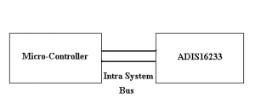
Intra System Protocol
The Intra system protocol is used to communicate the two devices within the circuit board.
Using intra system protocols circuit complexity and power consumption, the cost is decreased and it is very secure to accessing the data.

Slide 21
The different categories of intrasystem protocol mainly include the following.
I2C Protocol
SPI Protocol
CAN Protocol

Slide 22
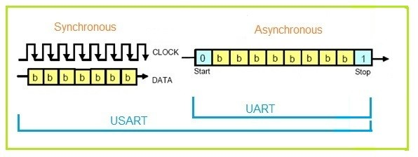
USART VS UART
USART | UART
UART is an asynchronous protocol, which means that it does not require a clock signal to synchronize data transfer between devices. | USART can be used in both asynchronous and synchronous modes. In synchronous mode, it uses a clock signal to synchronize data transfer, while in asynchronous mode, it behaves like a UART.
UART is a simpler and more widely used protocol, it is often more compatible with different devices and microcontrollers. | USART may require specific hardware or software support to be used effectively

Slide 23
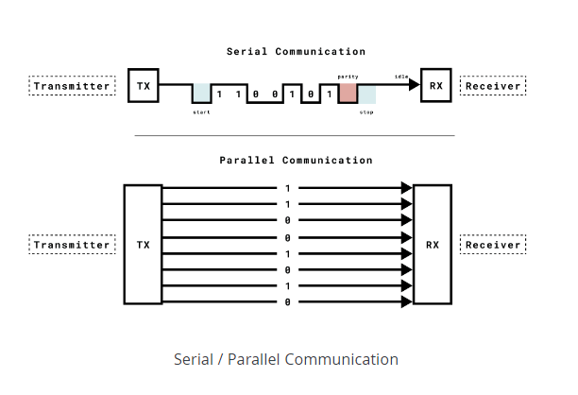

Slide 24
How many cables required for parallel and serial communication?
Parallel communication an 8-bit message would require eight cables
Serial communication only requires one cable for sending messages and one for receiving.

Slide 25
Components
Transmitter (TX):
Collects data from source
Formats into serial bits
Sends via TX pin
Receiver (RX):
Receives serial data on RX pin
Converts it into parallel data for host system
Baud Rate:
Defines speed of data transmission
Must match on both transmitter and receiver sides

Slide 26
Baud Rate
The baud rate is a fundamental parameter in UART communication.
It defines the speed at which data is transmitted over the communication channel.
The baud rate is specified in bits per second (bps) and represents the number of bits transmitted in one second.
In UART, both the transmitting and receiving devices must agree on the same baud rate to ensure successful communication.
Serial.begin(9600);

Slide 27
Flow Control in UART
Ensures reliable communication between fast transmitters (T) and slower receivers (R)
Prevents data loss when receiver cannot keep up
Receiver (R) signals transmitter (T) to:
  Pause transmission
  Resume transmission
Types of Flow Control
Hardware Flow Control
  Uses extra wires (RTS)Request To Send)/(CTS) Clear To Send
  Logic levels indicate stop/start
Software Flow Control
  special characters are sent over the normal data lines to start or stop the transmission.

Slide 28
UART Messages
In UART communication, each data frame is encapsulated by start and stop bits.
These bits serve a vital role in establishing the boundaries of data transmission and ensuring synchronization between the sender and receiver.

Slide 29
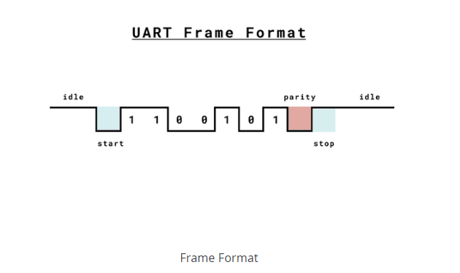

Slide 30
Start Bit
A single start bit is transmitted at the beginning of each UART frame.
The primary purpose of the start bit is to indicate the start of the data transmission and prepare the receiver for data reception.
The start bit is always logic low (0) for UART communication.
When the receiver detects a start bit, it knows that a new data frame is beginning, and it prepares to receive the incoming bits.

Slide 31
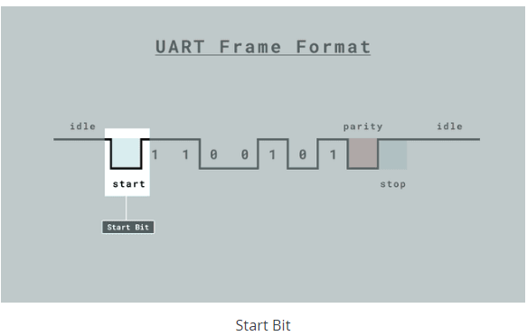

Slide 32
Data Bits
Data bits are a fundamental component of UART communication as they carry the actual information to be transmitted.
The number of data bits in a UART frame can vary, but a common and widely used configuration is 8 bits.
However, UART supports various character sizes, including 7-bit and 6-bit configurations, depending on the specific application requirements.

Slide 33
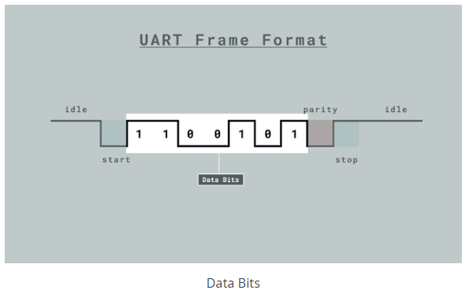

Slide 34
Data Integrity
The accuracy of data transmission in UART communication relies on the proper configuration of data bits.
It's essential that both the transmitter and receiver agree on the number of data bits and their encoding.
If the configuration is incorrect, data corruption can occur.
For example, if the transmitter sends data as 8-bit characters, but the receiver is configured to expect 7-bit characters, data may be misinterpreted, leading to errors in the received information.

Slide 35
Parity
Parity bit may be added to the data frame for error detection.
Receiver checks if received data matches expected parity.
If mismatch → error detected in transmission

Slide 36
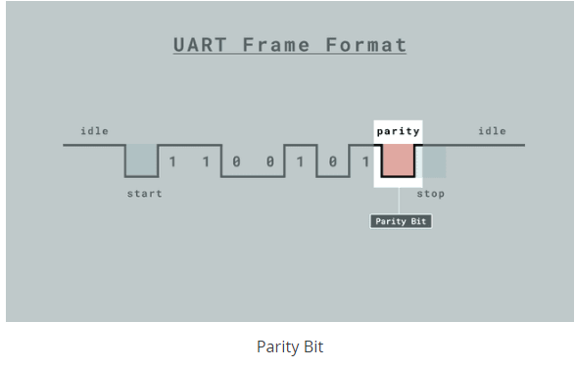

Slide 37
Stop Bits
one or more stop bits are sent after the data bits within each UART frame.
The stop bit(s) signal the end of the data byte and serve to indicate the conclusion of data transmission.
The most common configuration is to use one stop bit, but in situations where added reliability is required, two stop bits can be employed.

Slide 38
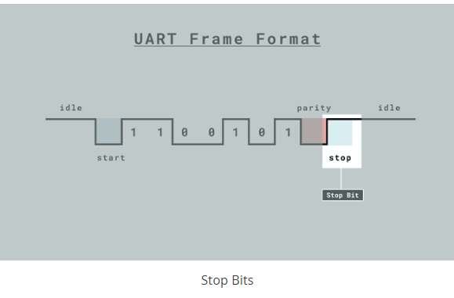

Slide 39
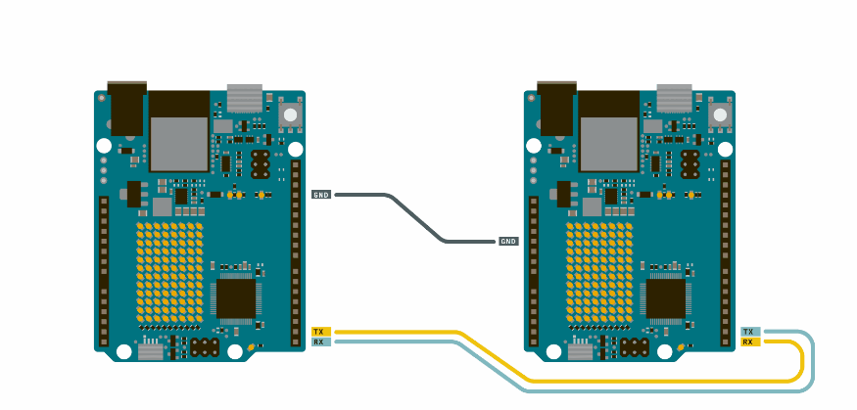
Send data between two Arduino boards.
To set it up, connect the TX with RX pins on both boards, following the circuit below:

Slide 40
Exercises
Explain How you will control the built-in LED by sending UART messages.
Write an Arduino Uno program to communicate with a GPS module via UART and display the received location data (latitude and longitude) on the Serial Monitor.

Slide 41
Serial Peripheral Interface (SPI)
Serial Peripheral Interface (SPI) is a synchronous serial data protocol used by microcontrollers for communicating with one or more peripheral devices quickly over short distances.

Slide 42
Serial Peripheral Interface (SPI)
With an SPI connection there is always one Controller device (usually a microcontroller) which controls the peripheral devices. Typically, there are three lines common to all the devices:
  Controller In, Peripheral Out (CIPO) - The Peripheral line for sending data to the Controller
  Controller Out Peripheral In (COPI) - The Controller line for sending data to the Peripherals
  Serial Clock (SCK) - The clock pulses which synchronize data transmission generated by the Controller, and
  Chip Select pin (CS) - allocated on each device which the Controller can use to enable and disable specific devices and avoid false transmissions due to line noise.

Slide 43
Code for a new SPI device
What is the maximum SPI speed your device can use? This is controlled by the first parameter in SPISettings. If you are using a chip rated at 15 MHz, use 15000000. Arduino will automatically use the best speed that is equal to or less than the number you use with SPISettings.
Is data shifted in Most Significant Bit (MSB) or Least Significant Bit (LSB) first? This is controlled by second SPISettings parameter, either MSBFIRST or LSBFIRST. Most SPI chips use MSB first data order.
Is the data clock idle when high or low? Are samples on the rising or falling edge of clock pulses? These modes are controlled by the third parameter in SPISettings.

Slide 44
Four Modes of Transmission in SPI
Mode | Clock Polarity (CPOL) | Clock Phase (CPHA) | Output Edge | Data Capture
SPI_MODE0 | 0 | 0 | Falling | Rising
SPI_MODE1 | 0 | 1 | Rising | Falling
SPI_MODE2 | 1 | 0 | Rising | Falling
SPI_MODE3 | 1 | 1 | Falling | Rising
These modes control whether data is shifted in and out on the rising or falling edge of the data clock signal (called the clock phase), and whether the clock is idle when high or low (called the clock polarity). The four modes combine polarity and phase (presented in the table)

Slide 45
SPI CONFIGURATION
SPI parameters, use SPI.beginTransaction() to begin using the SPI port. The SPI port will be configured with your all of your settings.
The simplest and most efficient way to use SPISettings is directly inside SPI.beginTransaction()
For example:
SPI.beginTransaction(SPISettings(14000000, MSBFIRST, SPI_MODE0))

Slide 46
I2C
A good way of adding complexity of features to your projects without adding complexity of wiring, is to make use of the Inter-integrated circuit (I2C) protocol.
The I2C protocol is supported on all Arduino boards.
It allows you to connect several peripheral devices, such as sensors, displays, motor drivers, and so on, with only a few wires.
Giving you lots of flexibility and speeding up your prototyping, without an abundancy of wires.

Slide 47
I2C
The I2C protocol involves using two lines to send and receive data: a serial clock pin (SCL) that the Arduino Controller board pulses at a regular interval, and a serial data pin (SDA) over which data is sent between the two devices.
In I2C, there is one controller device, with one or more peripheral devices connected to the controllers SCL and SDA lines.

Slide 48
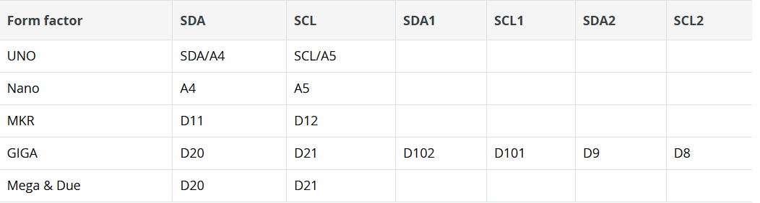
Arduino I2C Pins

